Slide 1

Crime Hotspot Detection
~ Virajsinh Parmar

Slide 2

Introduction
In today’s urban landscape, crime poses significant challenges to public safety and community well-being. Traditional approaches often rely on reactive measures, leaving gaps in prevention and strategic planning. This project addresses these challenges by harnessing LAPD crime data to develop a robust machine learning model for detecting crime hotspots in Los Angeles. By transforming raw crime records into actionable insights, the project not only highlights areas of heightened risk but also delivers targeted security recommendations for clients, while encouraging stronger collaboration with local law enforcement. Ultimately, this research underscores the role of data-driven intelligence in building safer communities.

Slide 3

Dataset Overview
--- Features ---
Row:
901357
DR_NO
DATE RPTD
DATE OCC
TIME OCC
AREA
AREA NAME
RPT DIST NO
PART 1-2
CRM CD
CRM CD DESC
MOCODES
VICT AGE
VICT SEX
VICT DESCENT
PREMIS CD
PREMIS DESC
WEAPON USED CD
WEAPON DESC
STATUS
STATUS DESC
CRM CD 1 TO 4
LOCATION
CROSS STREET
LAT-LON
Column:
28

Slide 4

Project Methodology
1.
Data Collection
2.
Data Cleaning
5.
Model Building
6.
Fine Tuning
3.
EDA
4.
Data Preprocessing
7.
Evaluation & Comparison
8.
Recommendation & Conclusion

Slide 5

Data Cleaning
Date Columns
(DATE OCC, DATE RPTD) :
Standardized to YYYY-MM-DD, removed time, and derived Year, Month, Day, Weekday for analysis.
Time Occ :
Converted 4-digit HHMM format into only Hour values.
Delay Days :
New feature showing gap between DATE OCC and DATE RPTD to study reporting delays.
Victim Age :
Removed invalid ages (0, negative, 100+). Created age categories: Minor, Young Adult, Adult, Middle Age, Senior.
Victim Sex :
Cleaned inconsistent values (X, H, “-”) and grouped as Unknown.
Victim Descent :
Filled missing with “X” and mapped codes to descriptive ethnicity names.

Slide 6

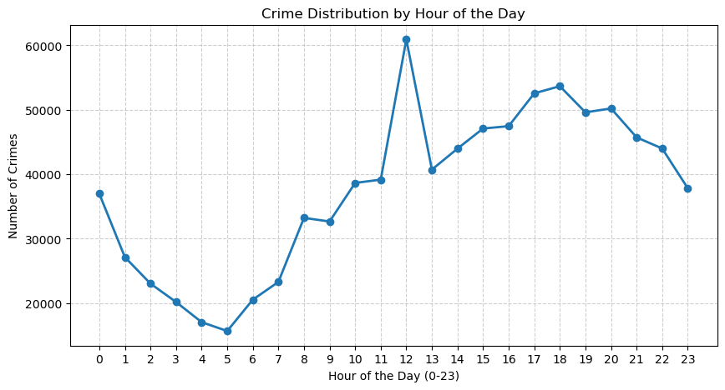
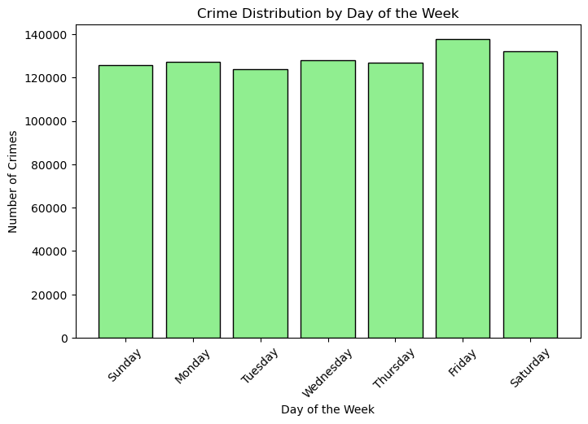
Exploratory Data Analysis

Slide 7
Insights 🔎 :
Hour of the Day:
Lowest crime between 3 AM – 6 AM.
Peak at 12 PM (noon), with another high phase in the evening (4 PM – 10 PM).
Crimes decline after 11 PM but remain higher than early morning.
Day of the Week:
Crime levels steady across the week.
Friday has the highest crime, followed by Saturday.
Tuesday shows the lowest crime count.
Weekends (Fri–Sat) are riskier compared to weekdays.
Targeted Security Recommendations 🛡 :
Time-Based Measures:
Deploy extra patrols during noon peak (11 AM – 1 PM) and evening hours (4 PM – 10 PM).
Improve street lighting & install CCTV in high-footfall areas.
Awareness campaigns for residents to avoid risky hours.
Day-Based Measures:
Reinforce policing on Friday & Saturday evenings in nightlife and shopping districts.
Adjust police shifts to ensure higher staff presence during weekends.
Partner with businesses & communities for weekend security patrols and neighborhood watch.

Slide 8
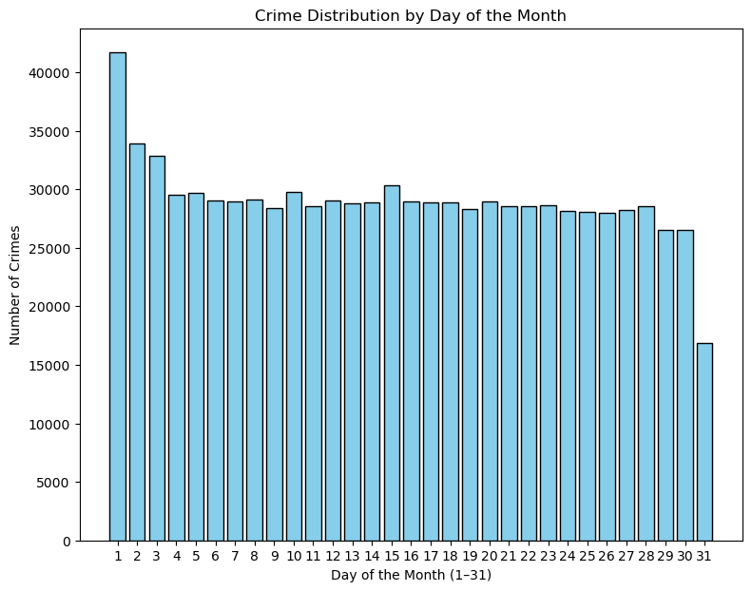
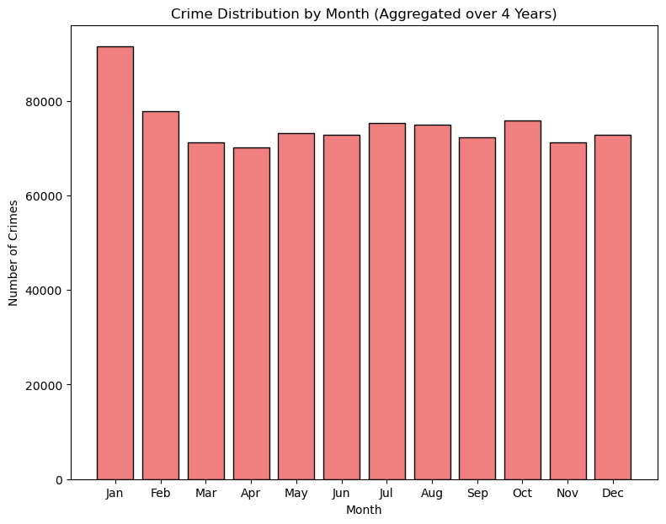

Slide 9
Insights :
Monthly pattern: January peaks (~92K crimes), ~25% higher than April (~70K).
Seasonal trend: Higher crime in winter (Jan–Feb) and summer (Jul–Aug, Oct); lowest in spring (Mar–Apr).
Month-start surge: Days 1–3 show dramatic spike (40K+ incidents vs. ~17K on day 31).
Mid-month stability: Days 15–31 remain steady (~27K–30K).
Targeted Security Recommendations :
Winter focus: Increase patrols/staffing by 20–25% in Jan–Feb.
Month-start protocol: Maximize security presence during days 1–5, especially in retail & financial hubs.
Seasonal allocation: Reduce resources in Mar–Apr low-risk phase; shift to peak months.
Client guidance: Advise high-risk operations in mid-to-late month when incidents are lower.
Predictive planning: Use temporal data to pre-position forces before seasonal and month-start peaks.

Slide 10
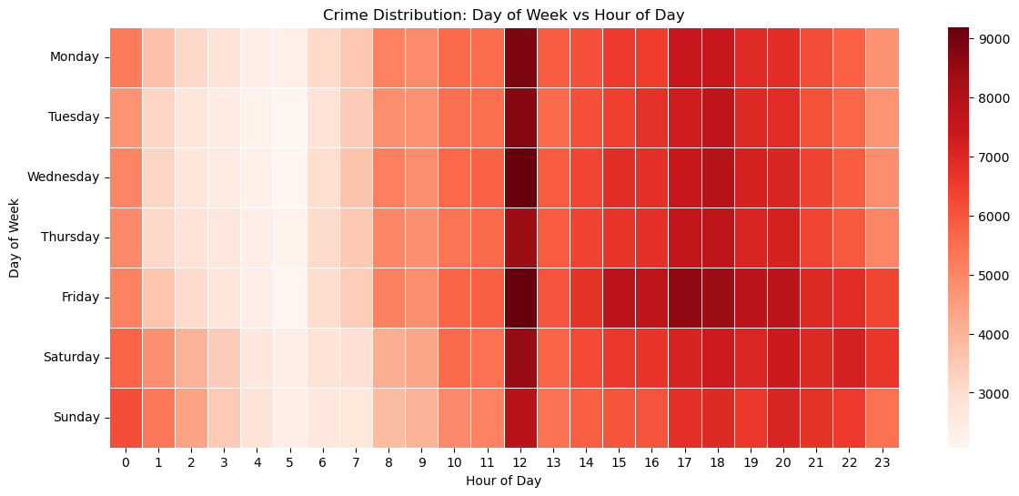
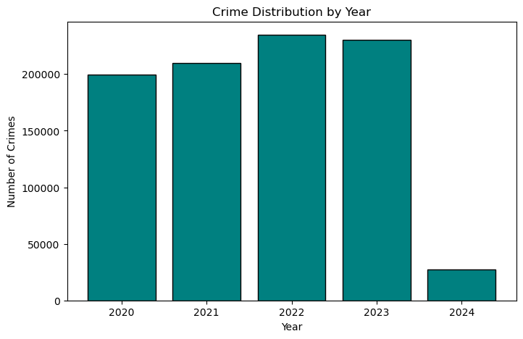

Slide 11
Insights :
Noon peak: 12 PM–1 PM is the critical high-risk window (~9,000+ incidents).
Weekday pattern: Tuesday–Thursday show the highest overall crime; Monday has slight morning elevation.
Evening surge: 6 PM–11 PM remains a sustained high-activity period (~7,000–8,000 incidents).
Safe hours: 1 AM–6 AM consistently lowest (<3,000 incidents).
Trend note: 2020 ≈200K → peak 2022 ≈240K → stable 2023 → sharp drop 2024 ≈25K (likely partial-year data).
Targeted Security Recommendations :
Lunch-hour focus (11 AM–2 PM): Increase patrols & surveillance; prioritize Tue–Thu when peaks converge.
Evening reinforcement (6 PM–11 PM): Deploy high-visibility patrols, improve lighting and CCTV in hotspots.
Low-risk scheduling: Encourage high-risk client operations in early morning (2 AM–7 AM) where feasible.
Weekday alert (Tue–Thu): Raise staffing by ~15–20% on these peak weekdays.
Predictive response teams: Stage rapid-response units shortly before the noon rush and evening surge.
Trend monitoring: Coordinate with law enforcement to confirm if 2024’s decline is real before changing long-term resource plans.
Dynamic allocation: Use daily/hourly probability matrices to scale security presence in real time.

Slide 12
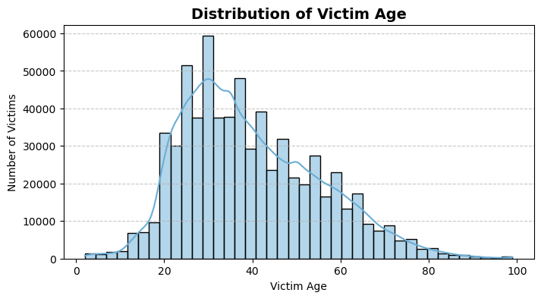
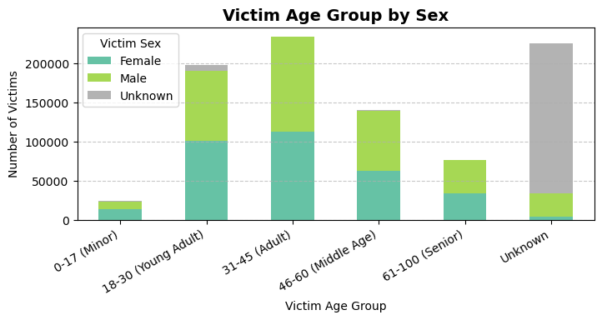
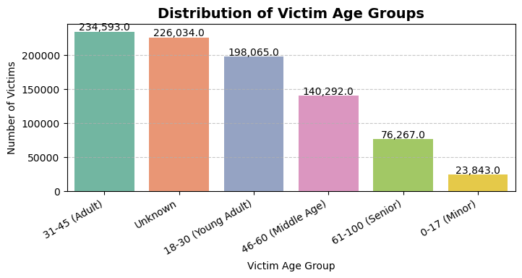
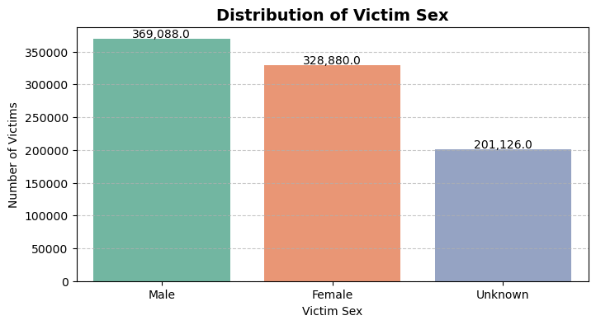

Slide 13
Insights :
Gender: Male victims (41%) slightly higher than females (37%); large Unknown category (22%) indicates data gaps.
Age group: Adults 31–45 most affected (~234K cases), showing working-age vulnerability.
Young adults (18–30): High risk (~198K cases), with peak at ages 25–30.
Middle-aged (46–60): Moderate risk (~140K cases).
Seniors (61+) & minors: Lower in count but high vulnerability, need tailored protection.
Data quality issue: Large “Unknown” (226K) may mask true victim patterns.
Targeted Security Recommendations :
Balanced protection: Apply gender-neutral security protocols; avoid male/female bias.
Prime-age adults (25–45): Prioritize in business hubs, residential complexes, transit routes.
Young adults (18–30): Focus on campuses, entry-level work areas, nightlife zones.
Age-tailored measures: High-visibility deterrence for working adults; discreet protection for seniors; child-focused safety for minors.
Data improvement: Work with law enforcement to reduce “Unknown” cases for sharper targeting.
Risk tools: Develop demographic-based vulnerability scoring and deploy specialized response teams by age group.

Slide 14
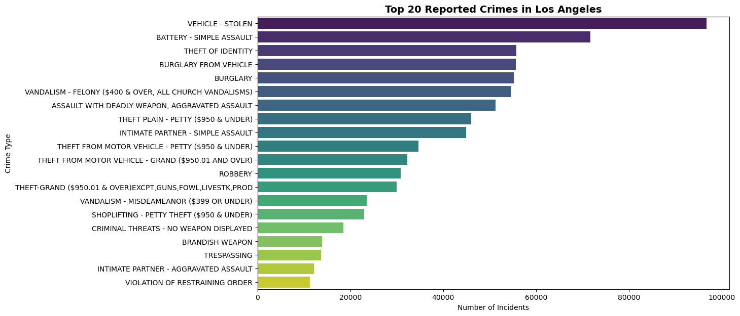

Slide 15
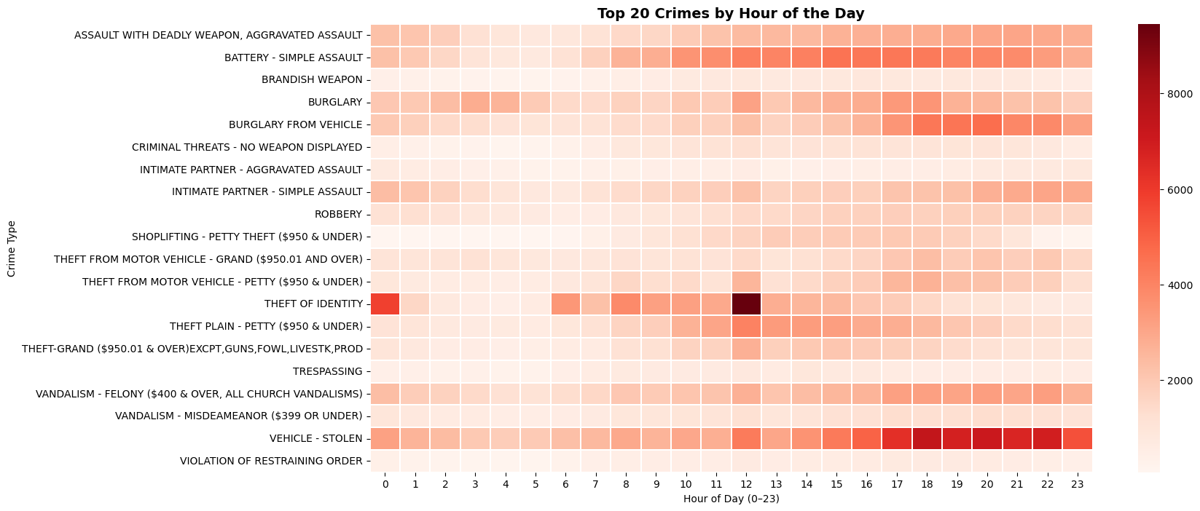

Slide 16
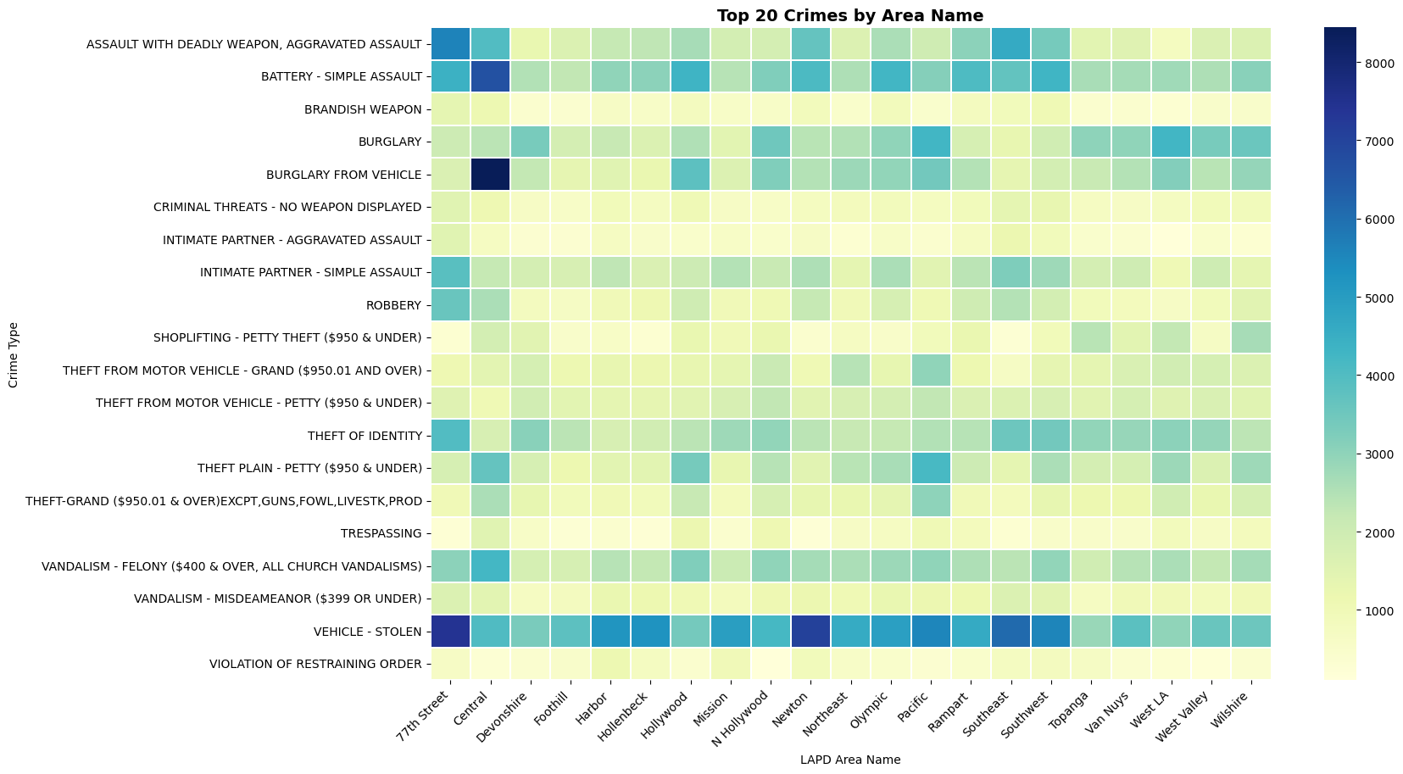

Slide 17
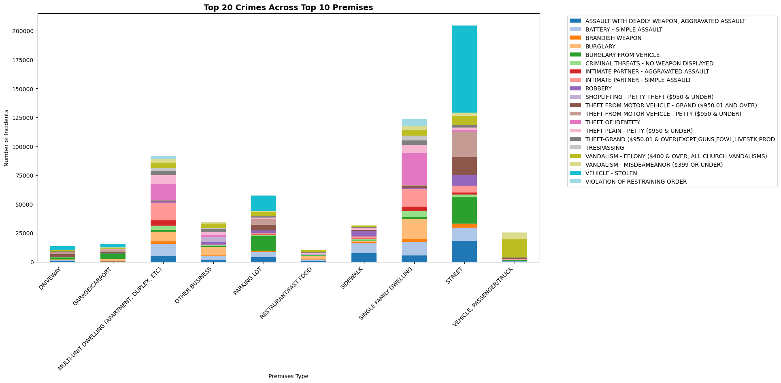

Slide 18
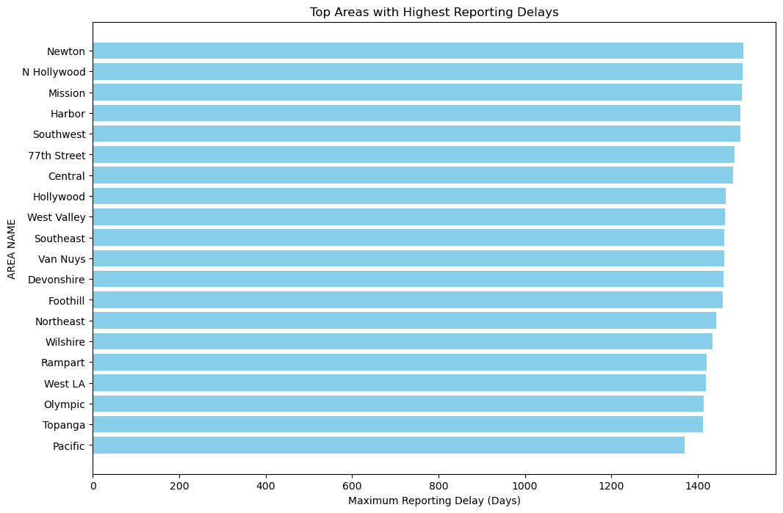

Slide 19
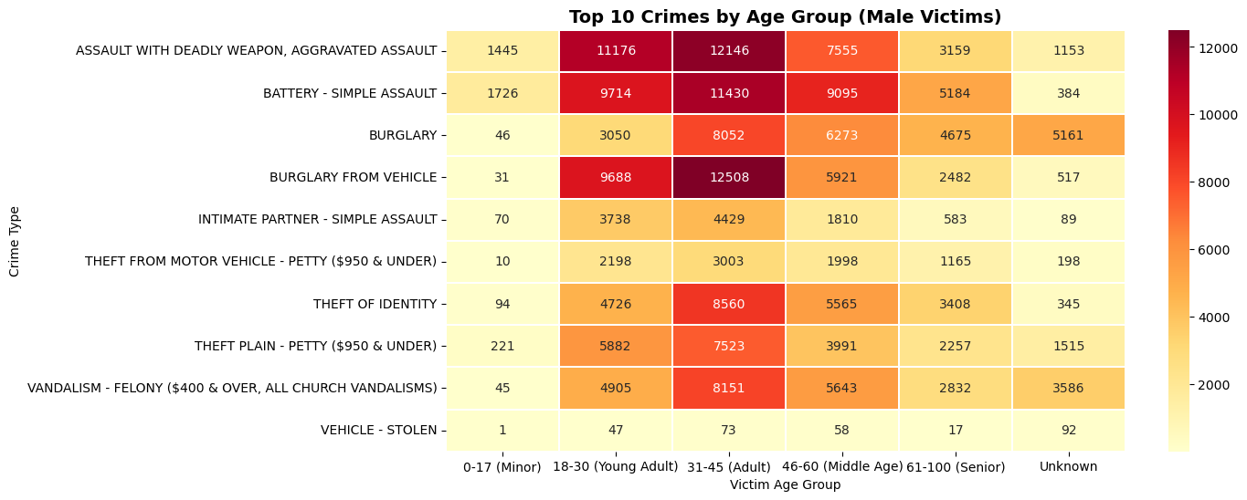

Slide 20
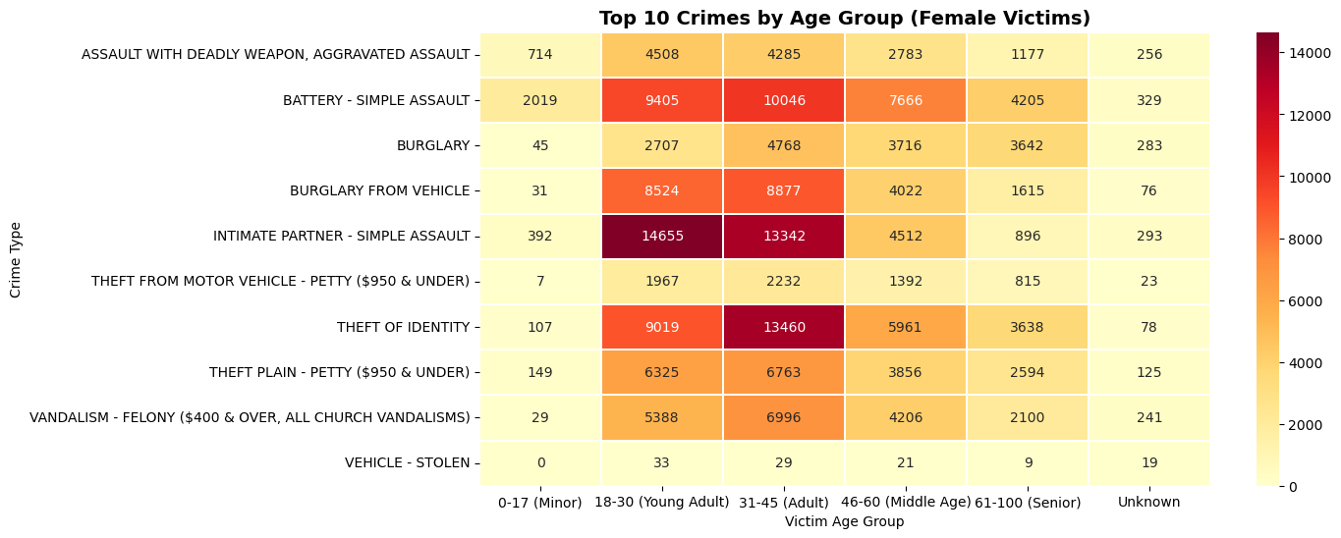

Slide 21
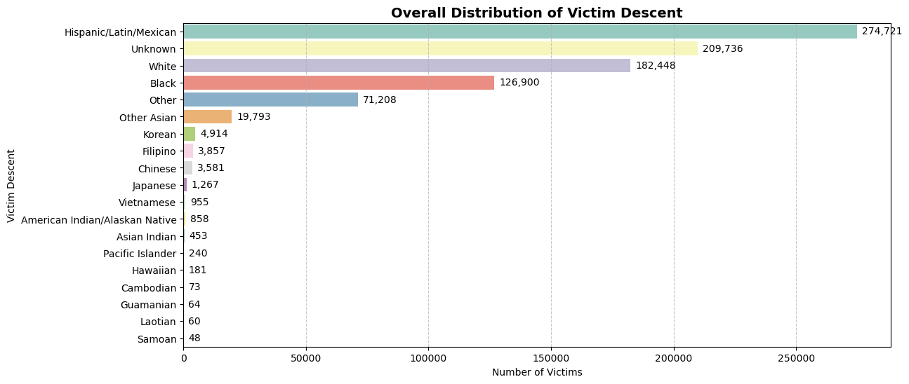

Slide 22
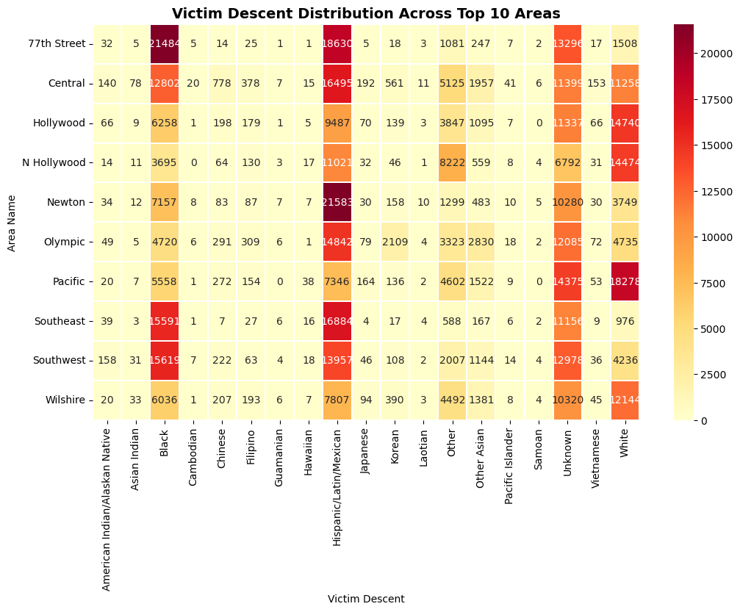

Slide 23
Key Insights :
Vehicle theft dominates Los Angeles crime (100,000+ incidents), followed by battery/simple assault (85,000+) and identity theft (55,000+), indicating property crimes are the primary threat
Critical time vulnerabilities identified: Noon (12 PM) shows peak activity with identity theft hotspots reaching 8,000+ incidents, while evening hours (6-11 PM) maintain consistently elevated risks
Geographic crime concentration: 77th Street area shows extreme burglary-from-vehicle clustering (8,000+ incidents), while Central, Hollywood, and Pacific areas demonstrate high overall crime density
Street-level crimes peak dramatically (200,000+ incidents) compared to other premises, with multi-unit dwellings showing secondary concentration (95,000+ incidents)
Systematic reporting delays across all areas (1,400+ day maximums), indicating potential under-representation of real-time crime patterns
Male victims show higher assault rates (12,000+ aggravated assaults in 31-45 age group), while female victims experience peak intimate partner violence (14,600+ cases in 18-30 demographic)
Hispanic/Latino community bears disproportionate burden (274,721 victims, 31% of total), followed by significant unknown demographic gaps (209,736 cases)
Age-based vulnerability patterns: 31-45 age group faces highest victimization across most crime types, with young adults (18-30) showing secondary peak exposure

Slide 24
Targeted Security Recommendations :
Deploy vehicle protection task forces in 77th Street, Central, and Hollywood areas with enhanced surveillance systems and rapid response protocols for auto theft prevention
Establish noon-hour security surges (11 AM-2 PM) with specialized identity theft prevention units targeting financial districts and commercial areas
Implement street-level patrol intensification with 200% resource allocation compared to building-focused security, emphasizing high-traffic pedestrian zones
Coordinate multi-jurisdictional response teams to address 1,400+ day reporting delays through real-time crime monitoring and predictive deployment systems
Develop culturally-responsive security services for Hispanic/Latino communities with bilingual emergency protocols and community liaison programs
Create age-targeted protection strategies: Enhanced workplace security for 31-45 demographic, campus/nightlife protection for 18-30 group, and specialized elderly safety programs
Establish gender-specific threat mitigation: Anti-assault protocols for male victims in public spaces, intimate partner violence prevention services for female victims
Deploy premise-specific security architectures: Maximum resources for street-level operations, secondary focus on multi-unit residential complexes with access control systems
Implement predictive crime mapping using geographic clustering data to pre-position security assets in 77th Street, Central, Hollywood, and Pacific high-risk zones

Slide 25

Data Preprocessing
In this project, the main objective is to identify crime hotspots across Los Angeles. Since geographical positioning is the foundation for hotspot detection, the features LAT and LON play the most critical role. Therefore, all preprocessing steps and the final modeling are designed specifically around these two columns to ensure accuracy in spatial analysis.
Outlier Handling (LAT/LON):
Defined valid Los Angeles range → LAT (33.0–34.5), LON (-119.0–-117.0)
Removed invalid coordinates falling outside this boundary.
Feature Scaling:
Applied StandardScaler on LAT & LON.
Standardization ensures better clustering and distance-based calculations.
Stratified Sampling:
Selected 10% of the data while preserving the AREA distribution.
Achieved a smaller yet representative dataset for faster and efficient modeling.

Slide 26

Model Building
In this project, crime hotspot detection is approached as an unsupervised learning problem because the dataset does not contain predefined crime hotspot labels. Instead of predicting known classes, the goal is to uncover hidden structures and natural groupings within the data. By applying unsupervised models, we aim to identify clusters of crime activity based on spatial coordinates (latitude and longitude), which ultimately reveal meaningful hotspot patterns for analysis and security planning.
Models Used :
K-Means Clustering
DBSCAN (Density-Based Spatial Clustering)
HDBSCAN

Slide 27
Model Building Process
K-MEANS | DBSCAN | HDBSCAN | Tuned_HDBSCAN
Optimal K chosen using Elbow Method → best range observed between K=2–4. Final selection: K=3 (most stable). Performance: Silhouette Score: 0.538 Davies-Bouldin Index: 0.586 | Parameter tuning with K-Distance Graph → suggested eps ≈ 0.2. However, results improved with eps = 0.12, min_samples = 200. Performance: Silhouette Score: 0.330 Davies-Bouldin Index: 0.660 | Parameters used: eps = 0.2, min_cluster_size = 400, min_samples = 400. Performance: Silhouette Score: 0.548 Davies-Bouldin Index: 0.561 | HDBSCAN (best model) further tuned. New Results: Silhouette = 0.552, DBI = 0.561 (minor gain). Reason: Data already well-structured, so parameter tweaks gave limited improvement → model close to optimal.

Slide 28
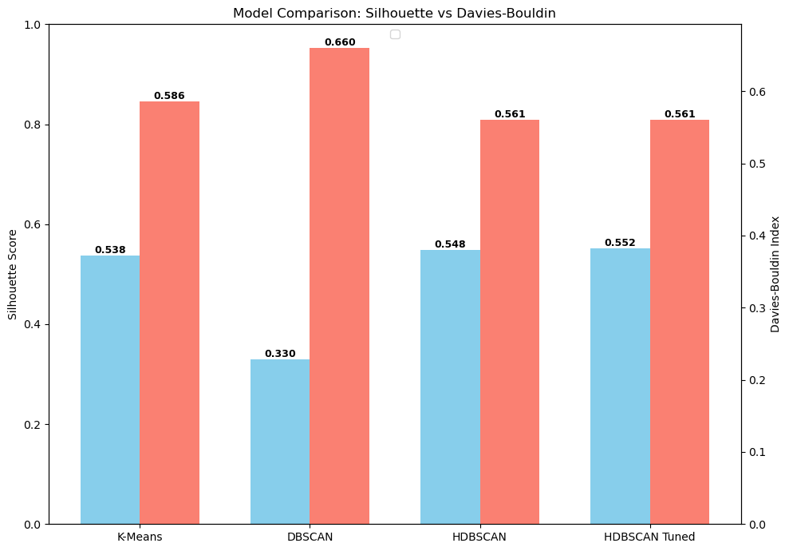
Model Comparison
Silhouette Score:
Measures how well-separated and cohesive the clusters are.
Ranges from -1 to 1, with values closer to 1 indicating better clustering quality.
Davies-Bouldin Index (DBI):
Evaluates the average similarity between clusters.
Lower values are better, as they indicate more compact and distinct clusters.

Slide 29
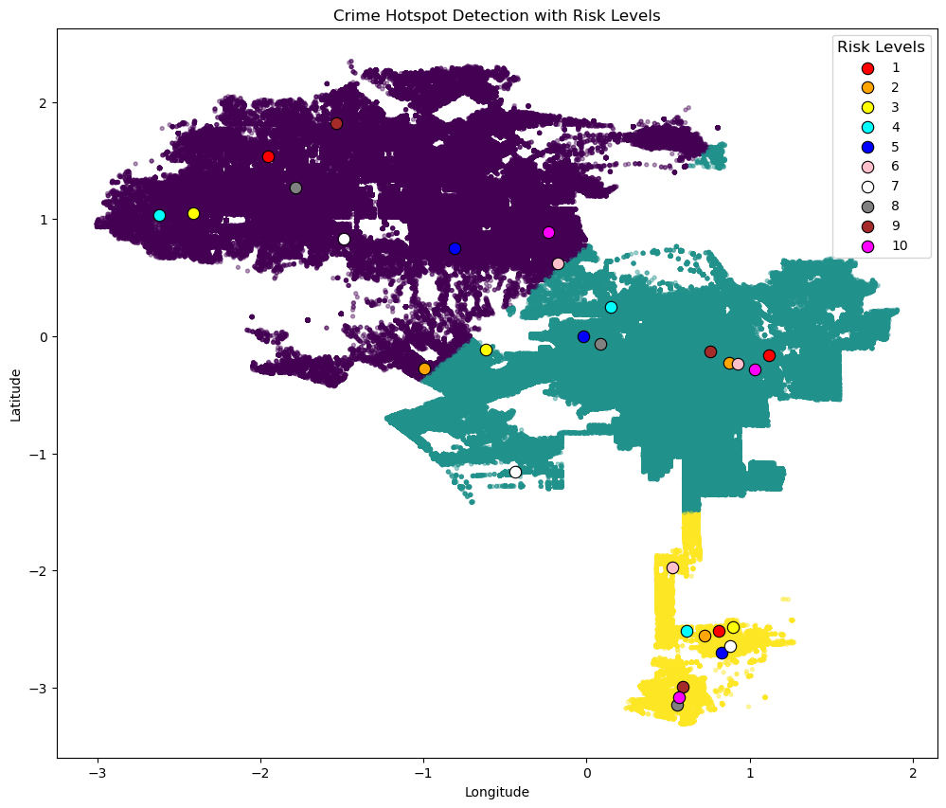
This plot, generated using the K-Means model, visualizes crime hotspots by highlighting the top 10 high-risk areas within each cluster. The risk levels are categorized into 10 distinct levels, with each level represented by a unique color. The legend indicates the mapping between colors and risk levels, making it easy to interpret the relative severity of each hotspot.

Slide 30
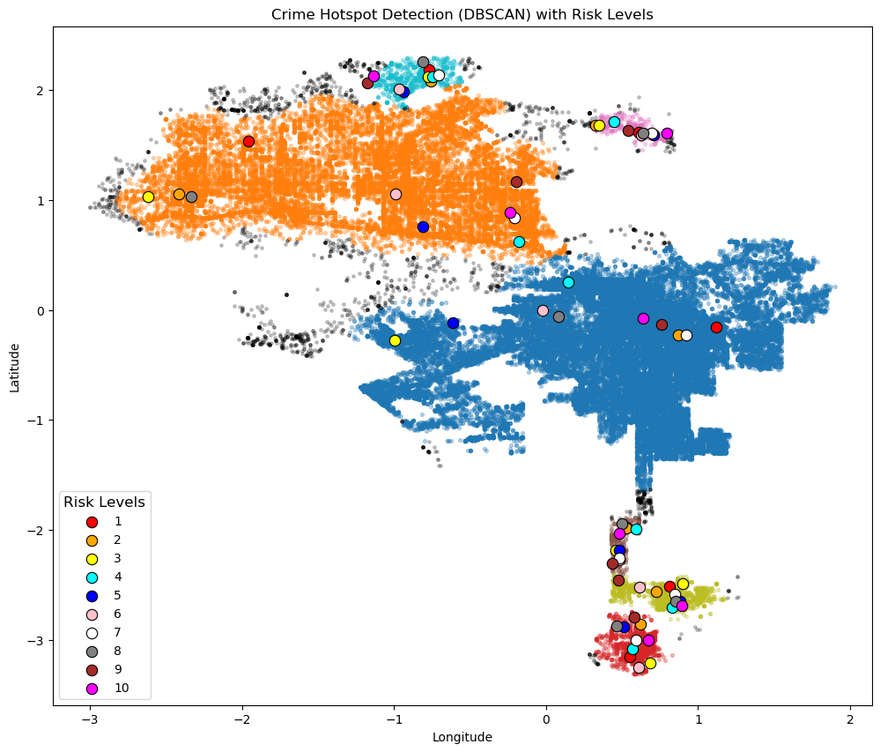
This plot, generated using the DBSCAN model, visualizes crime hotspots by highlighting the top 10 high-risk areas within each cluster. The risk levels are categorized into 10 distinct levels, with each level represented by a unique color. The legend indicates the mapping between colors and risk levels, making it easy to interpret the relative severity of each hotspot.

Slide 31
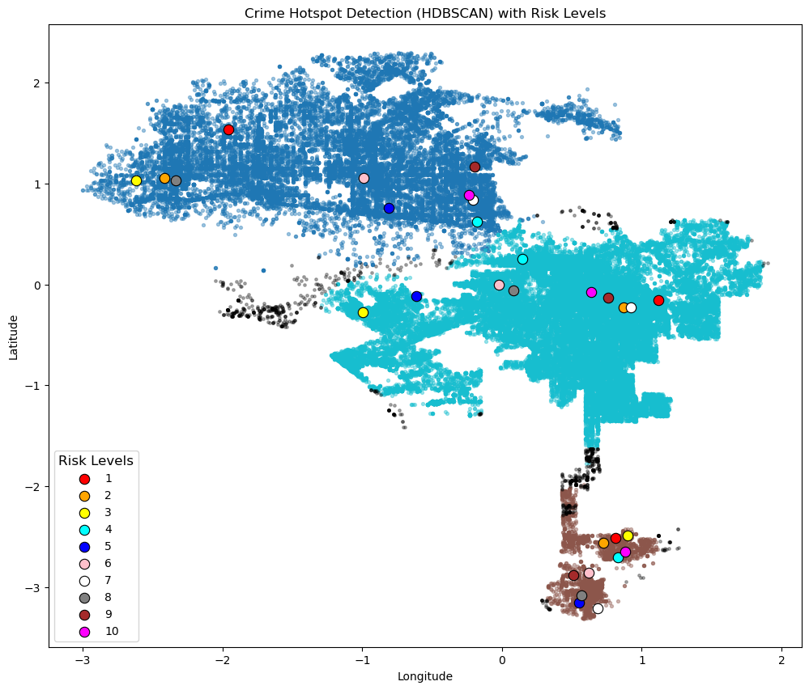
This plot, generated using the HDBSCAN model, visualizes crime hotspots by highlighting the top 10 high-risk areas within each cluster. The risk levels are categorized into 10 distinct levels, with each level represented by a unique color. The legend indicates the mapping between colors and risk levels, making it easy to interpret the relative severity of each hotspot.
This plot allows easy interpretation of high-risk areas, as the color-coded risk levels clearly highlight the most vulnerable hotspots.

Slide 32
Conclusion
This study demonstrates how advanced data-driven approaches can transform raw crime records into actionable intelligence. By leveraging unsupervised machine learning and geospatial analysis, we successfully identified and ranked high-risk hotspots across Los Angeles. The findings reveal clear temporal, demographic, and geographic crime patterns that empower proactive security planning.
Most importantly, the hotspot detection framework provides evidence-backed insights that enable law enforcement, private security firms, and urban planners to deploy resources strategically, enhance public safety, and minimize crime risks. This project highlights the power of combining data science with real-world security needs—turning numbers into meaningful action for safer communities.
Thank you.

